Slide 1
Health Protocols DV 2018-19
Emily Green

Slide 2
Introduction
Emily Green
Registered nurse for 10 years
BS from UNH, PhD in Nursing from UCSF
Background in adolescent medicine and research
Clinical background in medical surgical, labor and delivery, infectious disease, pediatrics
8 years working with charter schools in Los Angeles
2nd year with DV
Mom of 3 littles, live in El Segundo, husband works for Inglewood PD

Slide 3
School Nurse Role
Part time 16 hours/week across DVIA, DVS, DVC, DVD, DVRISE HAW and DVRISE APCH
Main duties are to
  Conduct special education health assessments and recommendations for special education services
  Write and evaluate and assist in implementation with 504 plans, individual health plans, nursing services associated with IEPs
  Evaluate general population health needs and support designated site staff to manage daily
  Training on site staff
  Overall health compliance including screenings, health reports, etc

Slide 4
Powerschool:
Emergency Medical Alerts
What is it?
How does it get there?
What do you do with it?
Examples:
  Wears glasses for all classroom activities
  Bathroom breaks as requested
  Status post surgery, modifications include XYZ

Slide 5
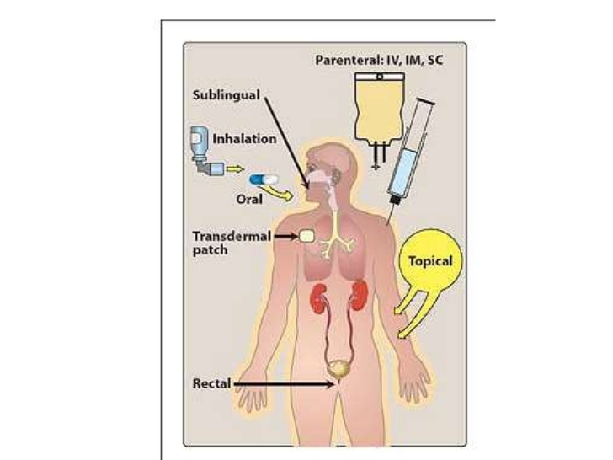
Medication at School
Schools must administer any prescribed medication to students
Parents must obtain authorization for medication at school form and have completed by a physician
Parents must provide the medication
School must train a designated, volunteer, trained staff
School must document the administration
Notify school nurse if students have medication on their person, I will confirm if we have an authorization

Slide 6
Field Trips
If you are taking students on a field trip, please sign out a first aid kit from front office.
At that time, please consult with front office to check list of students who take medication at school daily.
If you are taking a student with daily medication, please contact school nurse ASAP for training in medication administration

Slide 7
Asthma
Need authorization form for inhaler on campus
On person or in office
Any student using inhaler in class should have an alert, if not, email School nurse to ensure follow up
Any student needing attention for asthma treatment or complications, or any shortness of breath sent escorted to office

Slide 8
Individual Health Plans
  Students with chronic health conditions that require school based management
    Epilepsy
    Diabetes
    Life threatening or severe allergic reactions
    Technology dependent or medically fragile conditions
    Complicated or uncontrolled asthma
    Severe Anxiety or Depression with school based support or interventions

Slide 9
Who Needs a Health Plan?
What is a health plan?
  IHP ensures access to an education for students with special health care needs, whether or not the student is classified as eligible for SPED
  Gives the school necessary medical information about a child
  Identifies a child’s health needs, such as giving medication during the school day
  Creates solutions to potential health problems that can occur in a school environment
  Develops plans for emergency medical situations
  Provides a safe environment that helps a child learn
  Makes goals for a child’s health care, such as having a child work towards remembering to take medication

Slide 10
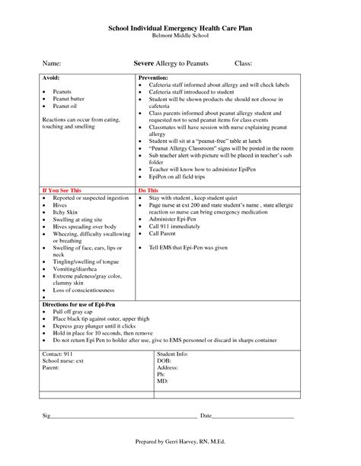
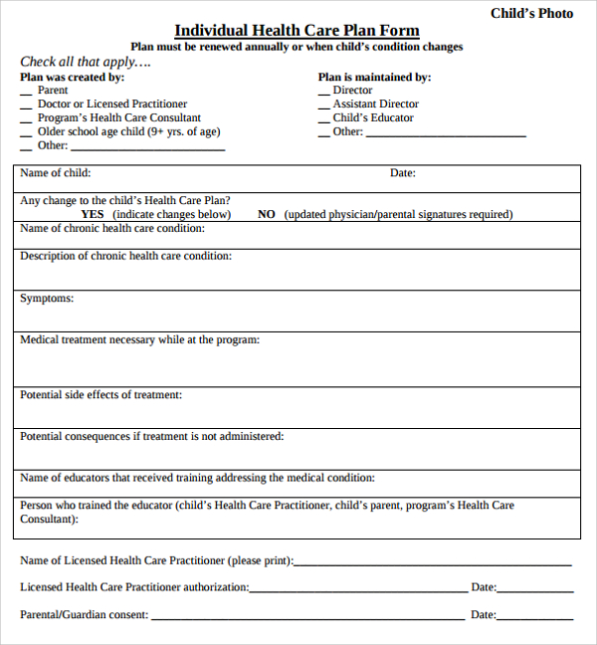

Slide 11
First Aid

Slide 12

Bumps and Bruises
Keep students in class!
Ice packs are available in the office for those with severe swelling

Slide 13

Injuries/Illnesses
If a student becomes ill at school, he/she is sent to the front health office. (accompanied if appropriate)
The school gives first aid only to injuries occurring at the school.
  DOCUMENT ON HEALTH LOG
School personnel are not authorized to treat any serious illness or injury, or to give any internal medication.
Water, ice, pressure and heating pads ONLY

Slide 14
Too ill to return to class
If they are too ill to return to the classroom or needs medical attention, the parent is notified.
  Emergency Contact list.
  No child is ever sent home alone when he/she is ill
  Cot in health office, not class, not counselor, not a hallway chair, etc.
If care beyond immediate first aid is needed for school injuries, we will contact the paramedics and abide by their recommendations.
  Parents will be contacted immediately.

Slide 15
Head Injuries
Any bump, blow or jolt to the head can cause a concussion.
A fall or blow to the body that causes head to move rapidly back and forth.
Symptoms of a concussion:
  Appears dazed, stunned, hazy
  Feeling headache, N/V, balance problems, fatigue, light or noise sensitivity, irritable, drowsy
  Is confused about events
  Answers slowly or repeats information
  Personality changes
All head injuries need to be documented in powerschool under log entry by the observer
Students with on campus head injury sent to office, will be evaluated and a form sent home to monitor symptoms
Students returning to school with an off-site concussion may have temporary modifications related to concussion

Slide 16
Other First Aid
See flip chart!

Slide 17

When to Call 9-1-1
Breathing Emergencies
  Not breathing
  Difficulty breathing/shortness of breath
  Choking
  Related to allergic reaction
  Trouble breathing after a bee sting
Loss of consciousness
  After an injury
  History of diabetes
  After seizure
  Unexplained reason

Slide 18
When to call 911 continued
Poisoning or overdose
Altered State
  Alcohol
  Drugs
  Disoriented
Uncontrolled bleeding, open wound
Head Injury
  With severe headache
  Vomiting/Behavior Changes
  Any severe injury to head, neck or back
Coughing/vomiting blood
Chest pain or pressure persisting more than 3-5 minutes or recurrent
Seizure
  First time
  Lasts more than 5 minutes
  Has a seizure and is pregnant
Sudden severe pain anywhere
Limb threatening injury

Slide 19
Calling 911
Verify address
Answer Questions
Follow Instructions
Do Not Hang Up
Stay Calm
Provide First Aid until ambulance arrives
Who do you tell?
  Administrator
  Front Office
  School Nurse
When do you notify the above?
  ASAP
  Certainly before you go home that day
  Via email or in person

Slide 20
And then…
Next Steps
  Administrator designates someone to
    Complete incident report
    Contact student’s immediate team
    Contact family (follow-up, re-entry)
    Alert SPED staff if needed
  Front office
    Is prepared to receive incident report
    Is prepared to have parent complete re-entry forms
  School Nurse
    Coordinates care with outside medical team if needed
    Creates health plan if needed
    Trains team on care plan
    Follow up on incident report

Slide 21

Incident Report Forms
Soft copies available
Can be completed online
Are completed for all staff and student incidents that require professional medical attention
Enable families to submit ambulance transport to insurance
HR, front office, and school nurse need a copy

Slide 22
Re-entry to school following a medical event
Following 911 transport or hospitalization
  Parent MUST notify school before student returns via phone call or email to front office, admin, or school nurse
  Parent must sign student in to front office and give documentation (if applicable) from MD indicating any school based care required.
  Front office will communicate this to admin, school nurse, counselor, RSP as necessary
School nurse will
  Create/Amend IHP if necessary
  Notify teachers of any accommodations
  Document in powerschool
  Follow up with medical team

Slide 23
Misc Health Related Topics

Slide 24

Vision and Hearing Screening
VISION: Test all students on school entry and every third year thereafter through grade eight.
HEARING: Each pupil shall be given a hearing screening test in kindergarten or first grade and in second, fifth, eighth, tenth or eleventh, and first entry into the California public school system.
Email school nurse to refer ANY student

Slide 25

Hygiene Product Availability
Assembly Bill No. 10 went into effect on Jan 1st 2018, which will require all public and private school facilities (and charter!) to provide dispensed feminine hygiene products (pads and tampons)
Hygiene items available in office for any student in need (deodorant, mouth wash, toothbrush). Refer to office or connect with school nurse

Slide 26
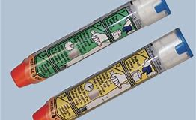
Epi-pens
California EC Section 49414, California public schools must train designated school personnel in the administration of life-saving epinephrine to students and adults who are experiencing severe allergic reaction and anaphylaxis.
Anaphylaxis is a potentially life-threatening hypersensitivity to a substance.
Schools must maintain a supply epi-pens on campus
Where to obtain?
Who trains the staff?
Want to be trained? Look out for mass training email coming in Sept

Slide 27
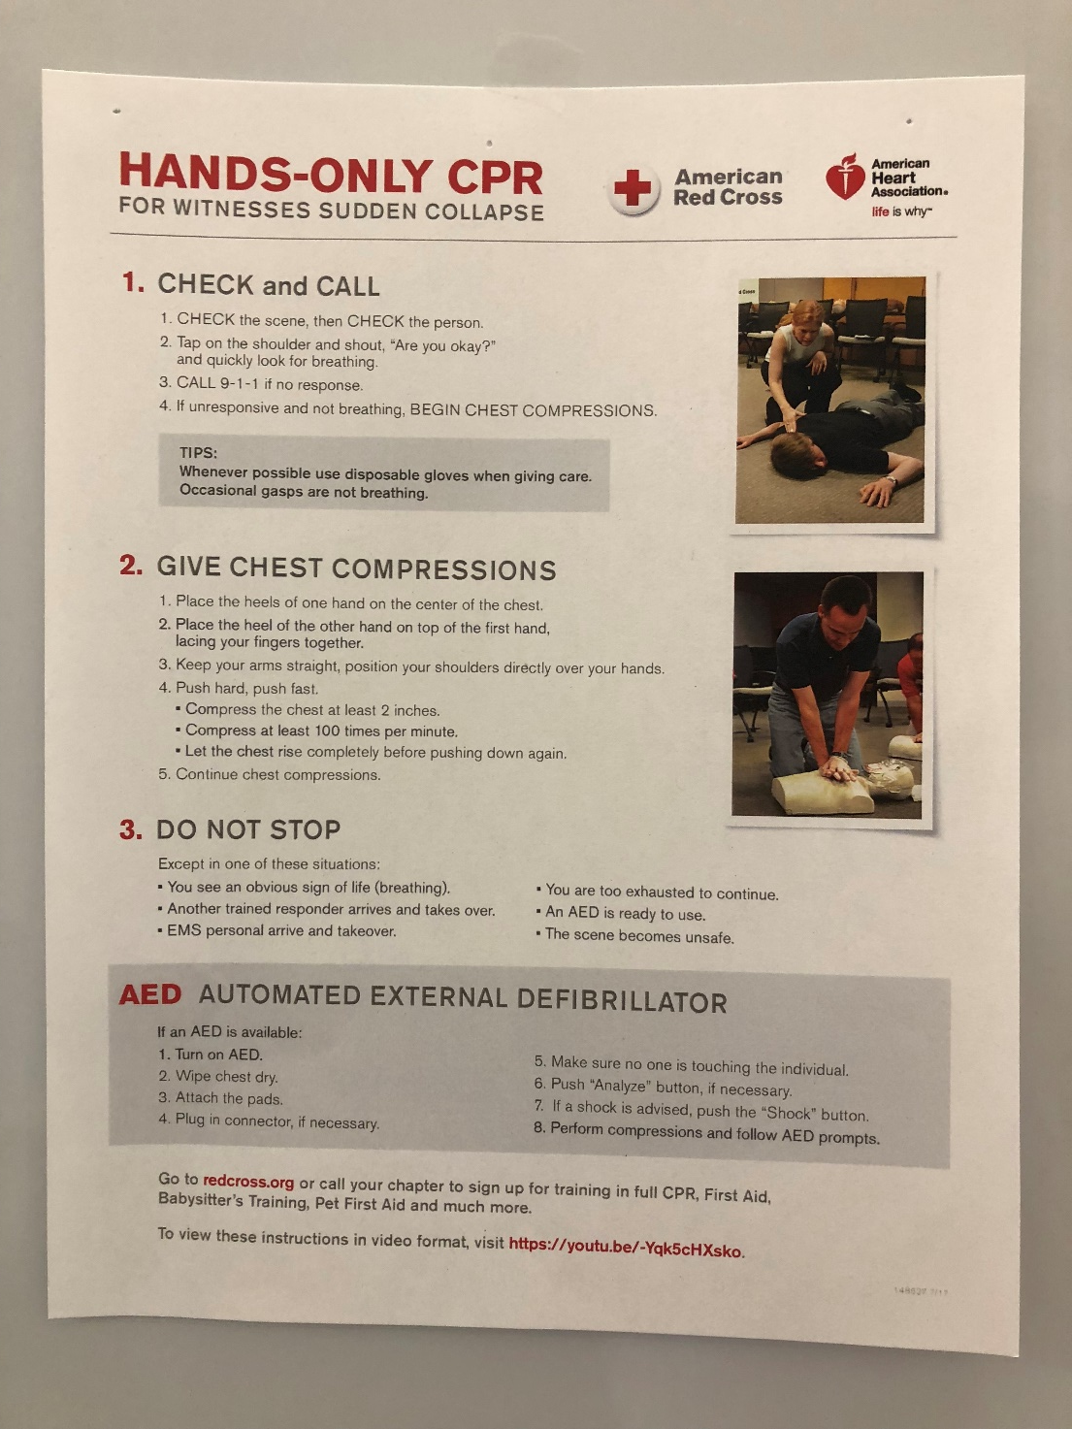
Hands Only CPR
AB 1719 Hands-only CPR training becomes a standard part of high school curriculum**
I will include in the Epi-pen training for staff who are interested
We can teach student groups if anyone is interested, contact me!

Slide 28
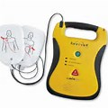
AEDs
AB 1639 enacts the Eric Paredes Sudden Cardiac Arrest Act which requires mandatory cardiac screenings and the required placement of Automatic External Defibrillators (AED) in schools and youth centers
Where are ours?
Do you know how they work?

Slide 29
Immunizations
Da Vinci Schools follow all requirements of the California School Immunization Law, Health and Safety Code Sections 120325-120375.
Incoming students are responsible to submit their complete immunization records.
The school will maintain a list of unimmunized children (exempted or admitted conditionally), so they can be excluded quickly if an outbreak occurs.

Slide 30
Lice
Prevention is important
Instruct your students not to share personal items like combs, brushes, caps, clothing, etc.
If a student does have lice, parents are told to notify school.
If it is discovered at school that student has lice, parents are notified and asked to pick up student.
Treatment of the student and home environment occurs prior to re-admission.
Parents must bring children to the school office to be checked before being readmitted to school.
Current policy: ALL NITS MUST BE REMOVED BEFORE RETURNING TO SCHOOL.

Slide 31
Sex Education- CHYA
The California Healthy Youth Act, requires school districts to provide students with integrated, comprehensive, accurate, and unbiased comprehensive sexual health and HIV prevention education at least once in middle school and once in high school.
Parents may view the curriculum and other instructional materials by request. Parents may opt-out from instruction if they so choose by requesting in writing that their student not receive the instruction.
Each DV school utilizes their own curriculum/planning
Did you know?
  Students can be excused by nurse to go to a clinic for birth control/abortion/rape services, etc. Refer to myself and counselor! More information coming soon

Slide 32
Other referrals
Hygiene
If you know a student will be/is out due to medical reasons, reach out to admin/school nurse r/t Home Hospital
Want a PD? A Health presentation?

Slide 33
Emergencies
  Standardized Emergency procedures? SEE SCHOOL SAFETY PLAN
  Classroom first aid bags? WHATS IN YOURS?
  Evacuation? DO YOU KNOW YOUR PLAN?

Slide 34
Contact
  Questions?
  Emily Green
  Egreen@davincischools.org
  310-970-4650
  310-725-5800 ext 3049

